Slide 1


Disaster Data Visualizer
Explore, analyze, and understand the patterns of disasters worldwide.
DASHBOARD

Slide 2
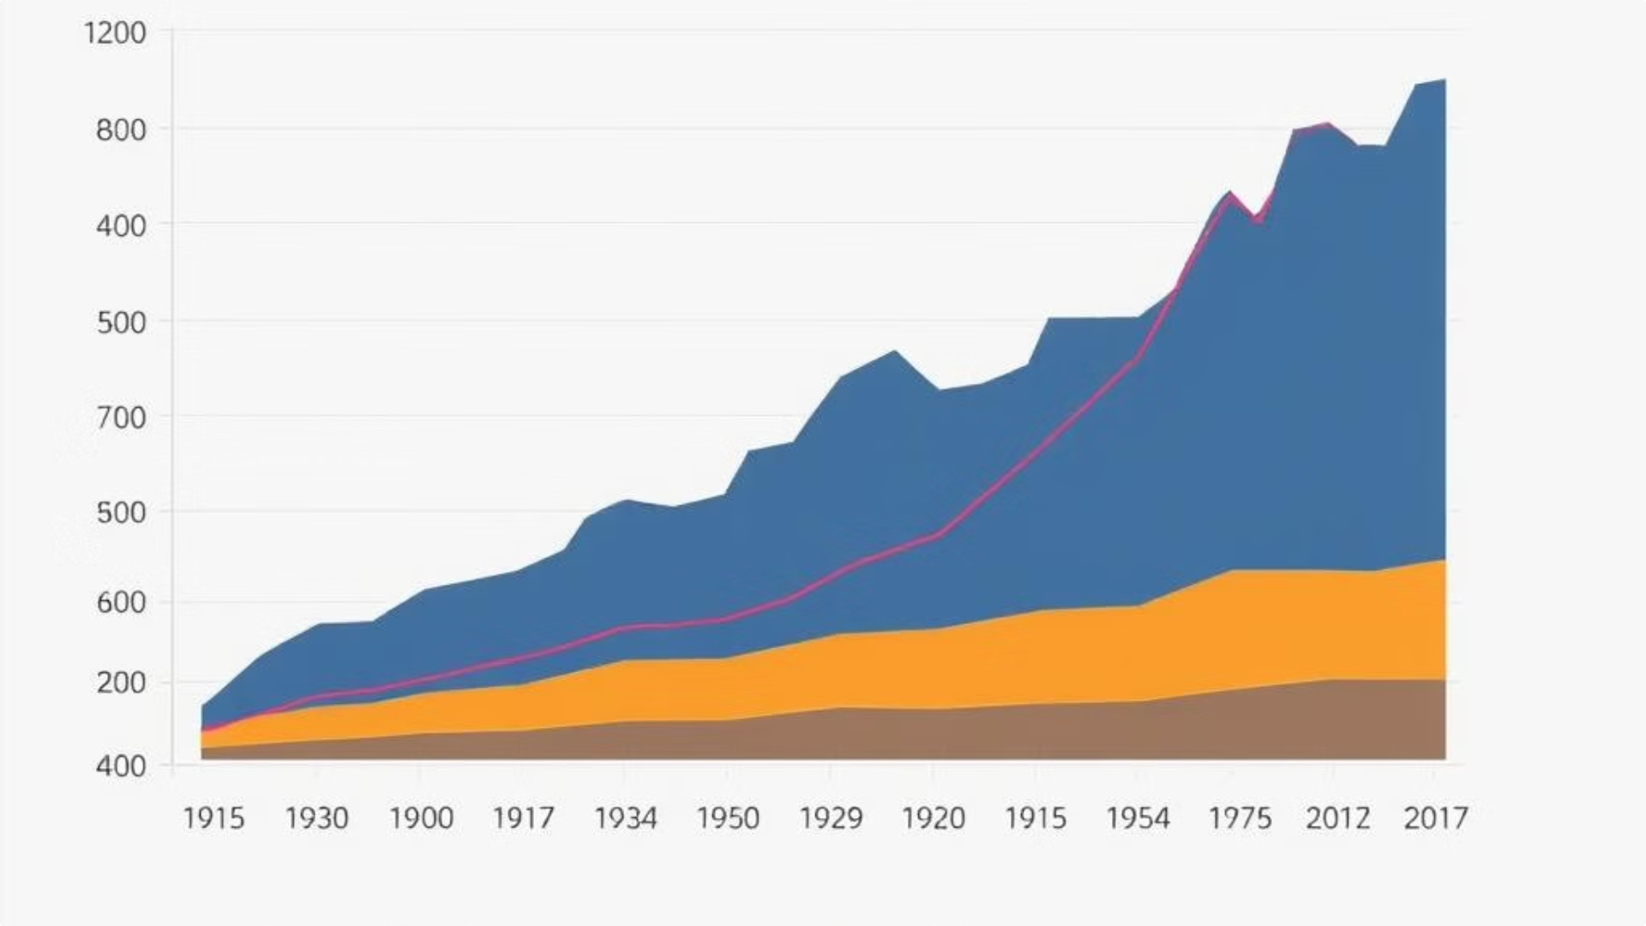
Understanding Disaster Trends Over Time
Frequency of Floods
Cyclone Fatalities
The dashboard displays the frequency of floods over time, allowing users to understand how often they have occurred in specific regions.
Users can explore the human toll of cyclones, visualizing the number of fatalities caused by these storms over time.
1
2
3
Earthquake Impact
This visualization showcases the economic impact of earthquakes, highlighting the cost of damage caused by these events.

Slide 3
Filtering and Drilling Down into Data
Disaster Type Filter
Year Range Slider
Multiple Disaster Metrics
Users can select a specific disaster type, such as floods, earthquakes, or wildfires, to focus their analysis.
A slider allows users to zoom in on a specific timeframe, like 2010 to 2020, to understand disaster patterns within that period.
The dashboard presents key metrics such as frequency, economic impact (in USD), and human impact (fatalities) for selected disaster types.

Slide 4
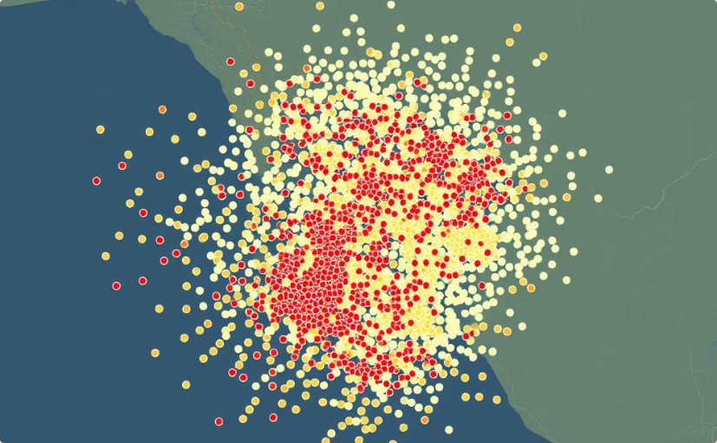
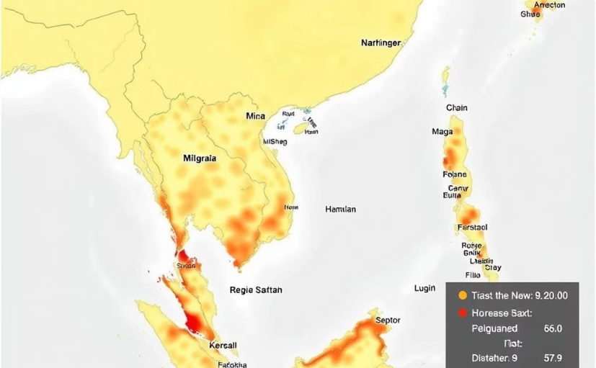
Interactive Geospatial Visualizations
Scatter Plots
Heatmaps
Scatter plots visually represent the location of disasters worldwide, providing a clear understanding of their geographical distribution.
Heatmaps illustrate the density of disaster events across different regions, highlighting areas that are most vulnerable to disasters.

Slide 5
Visualizing Economic Impact
Economic Damage Assessment
Regional Comparisons
Long-term Trends
Users can compare the economic impact of disasters across different regions, identifying areas that experience the most significant economic losses.
The dashboard allows users to analyze how the economic impact of disasters has changed over time, highlighting potential trends and patterns.
The dashboard displays the economic impact of disasters, measured in USD, showing the financial cost of these events.

Slide 6
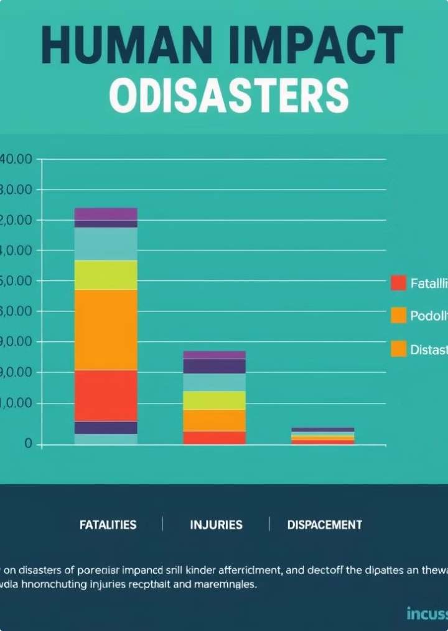
Understanding Human Impacts
Disaster Type
Fatalities
Injuries
Displacement
Floods
10,000
50,000
100,000
Earthquakes
5,000
20,000
50,000
Wildfires
2,000
10,000
20,000

Slide 7

Insights and Applications
1
Disaster Preparedness
The dashboard provides valuable insights for planning disaster preparedness strategies, enabling agencies to focus resources on high-risk areas.
2
Risk Assessment
Researchers can use the dashboard to assess the risk of future disasters, identifying potential areas and events with high impacts.
3
Policy Development
Policymakers can leverage the data to inform decisions about disaster response, mitigation, and recovery efforts.
4
Public Awareness
The dashboard can be used to raise public awareness about disaster risks and promote preparedness measures within communities.

Slide 8
Code Repository and Documentation
Source Code and Data
Technical Report

Slide 9
A PRESENTATION BY :
YUVRAJ
BAJPAI
PRIYANSHU
SHARMA
SAMARTH
KEDIA

